Slide 2
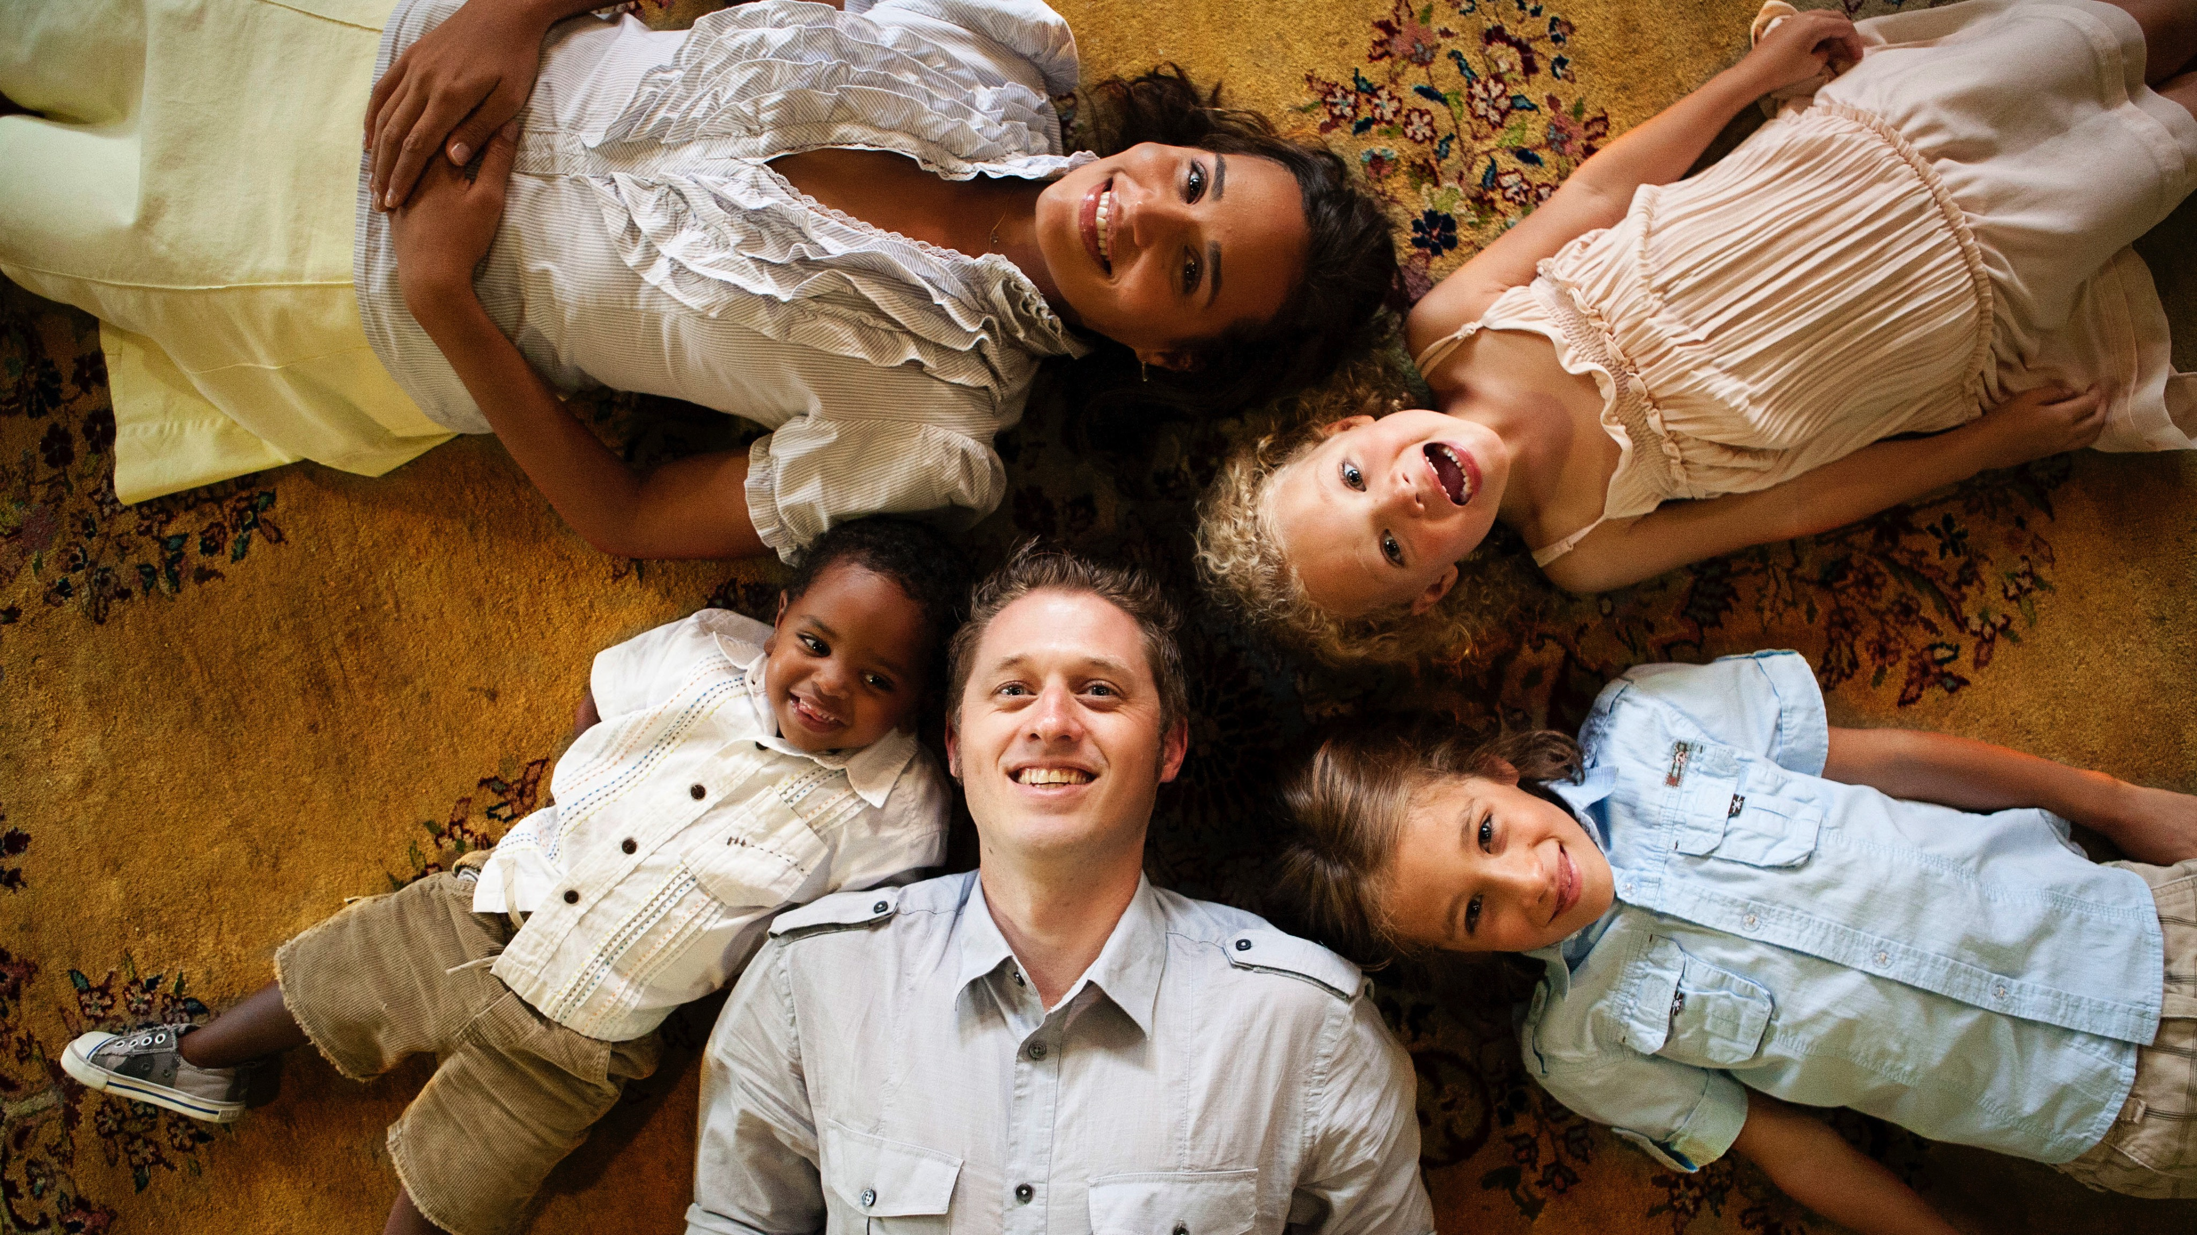
Presentation
Title
1
1

Slide 3
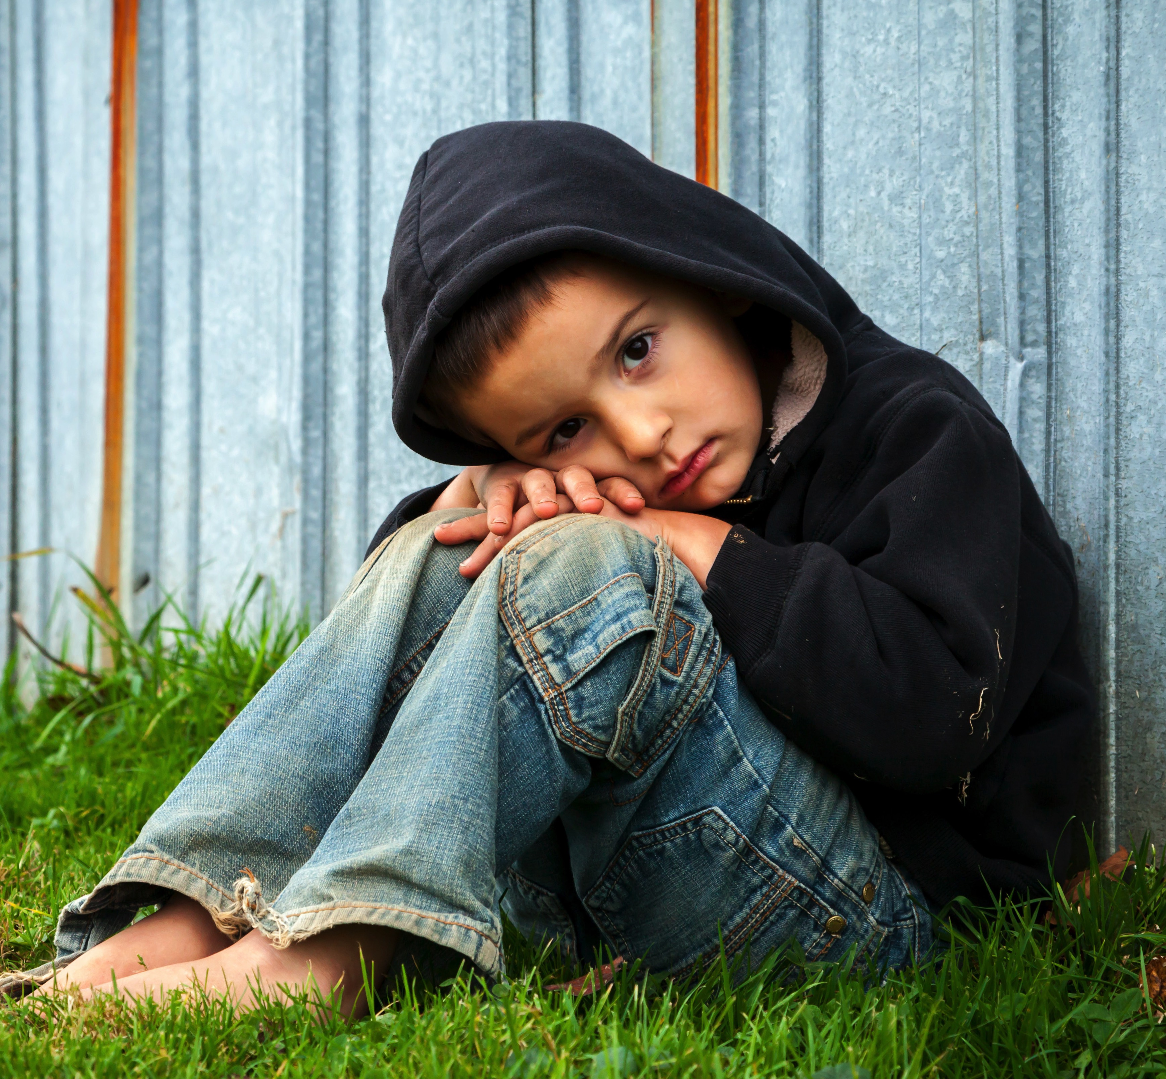
I was a stranger and you took me in…
Matthew 25:35

Slide 4
These children are not something we can legislate to the government
Foster Care Children in the U.S.
408,275
Girls in child welfare system
pregnant by 19
50%
Former child welfare wards
who “aged out” now in prison.
74%
Percentage of children Incarcerated with in 2 years of “age out”
50%
*Statistics provided by
the US Administration for Children and Families, the US Department of justice, the Casey Foundation and the National Foster Care Coalition.
% of death row inmates
who were in state care
80%

Slide 5
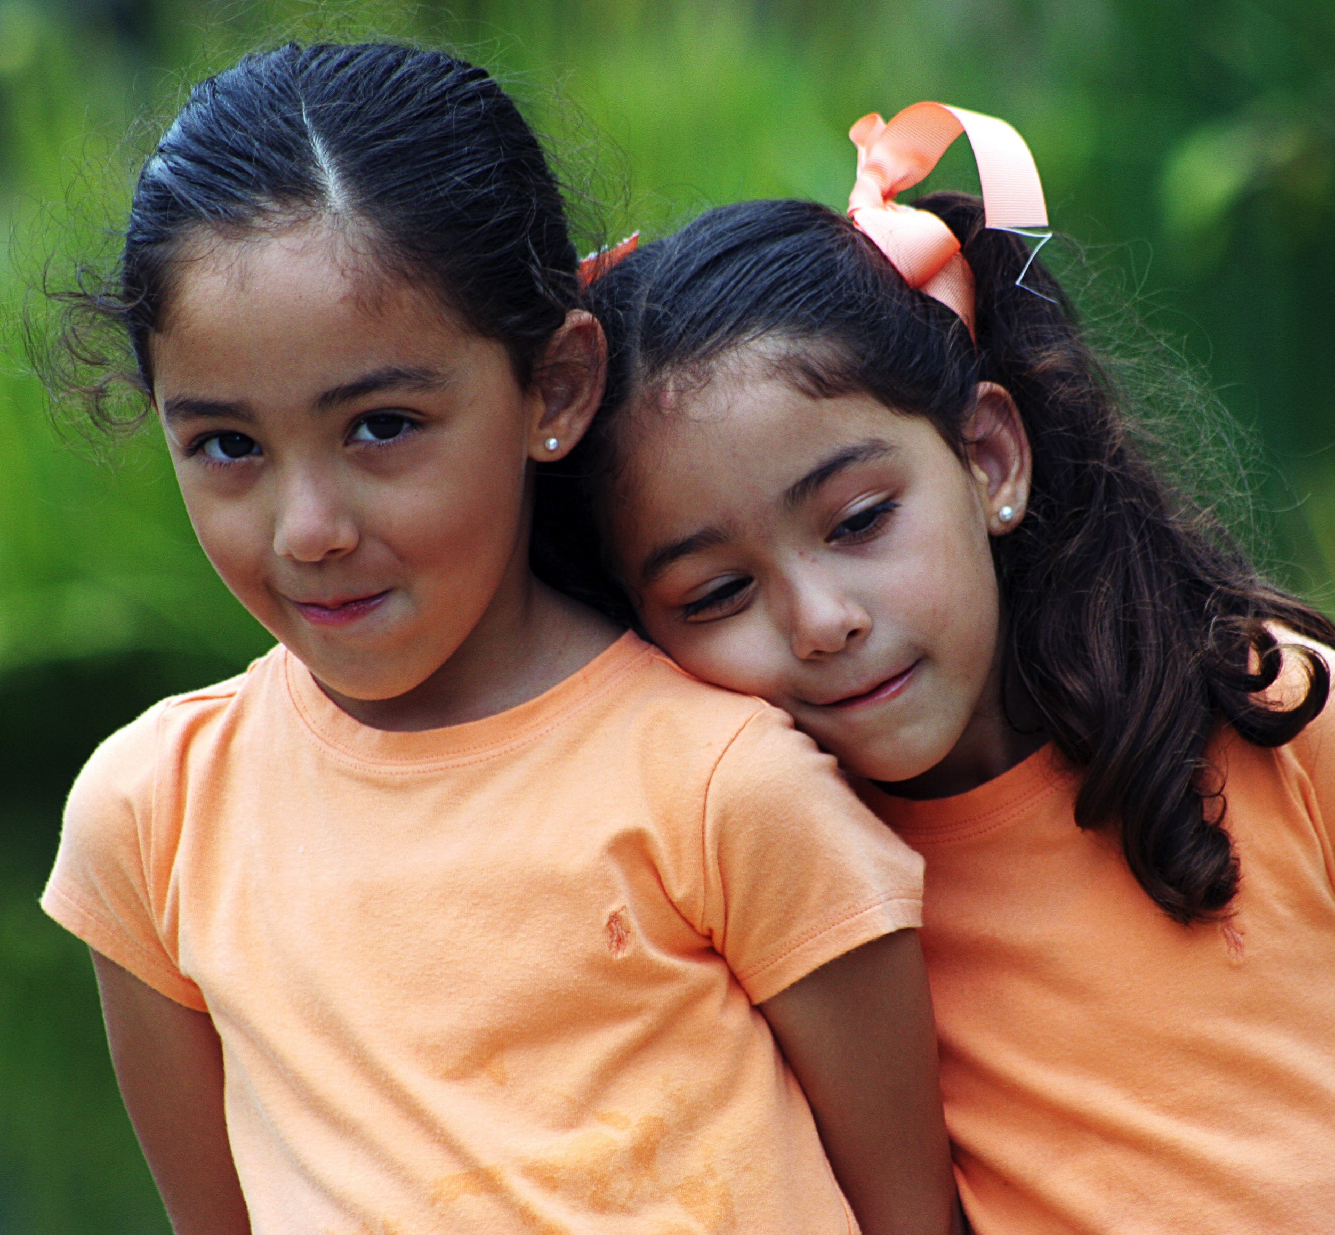
Of the 17,000+
“at-risk” children in AZ
• The majority of that number
are children from ages 3-17
• 60-80% have been removed
for neglect
• Most will remain in state care
between 3-5 years

Slide 6

17,000 children
Over 17,000 children is nearly to a sold out game at Madison Square Garden

Slide 7
State Care and Statistics
31%
Less than 1%
50 to 80%
of homeless population was
in state care
of these children ever go to college.
of commercially sexually exploited children have been involved in the child welfare system.
25%
25%
of kids who “age out” of foster care never graduate high school.
by the age of 21 will become pregnant.

Slide 8

The Call
From Moses to Jesus, God uses foster children for the benefit of humanity. And while there are at least 45 direct biblical references to mercy or justice for the orphaned and fatherless, there are many more indirect references that send a clear message:
the church must answer God’s call and accept the responsibility of foster care.

Slide 9
The numbers may seem overwhelming,
but think about this…
If every church would commit to care for
17,000
children
8,000 +
Churches
2 children
The children
“at-risk”
crisis would
be ended.
In care of the state.

Slide 10
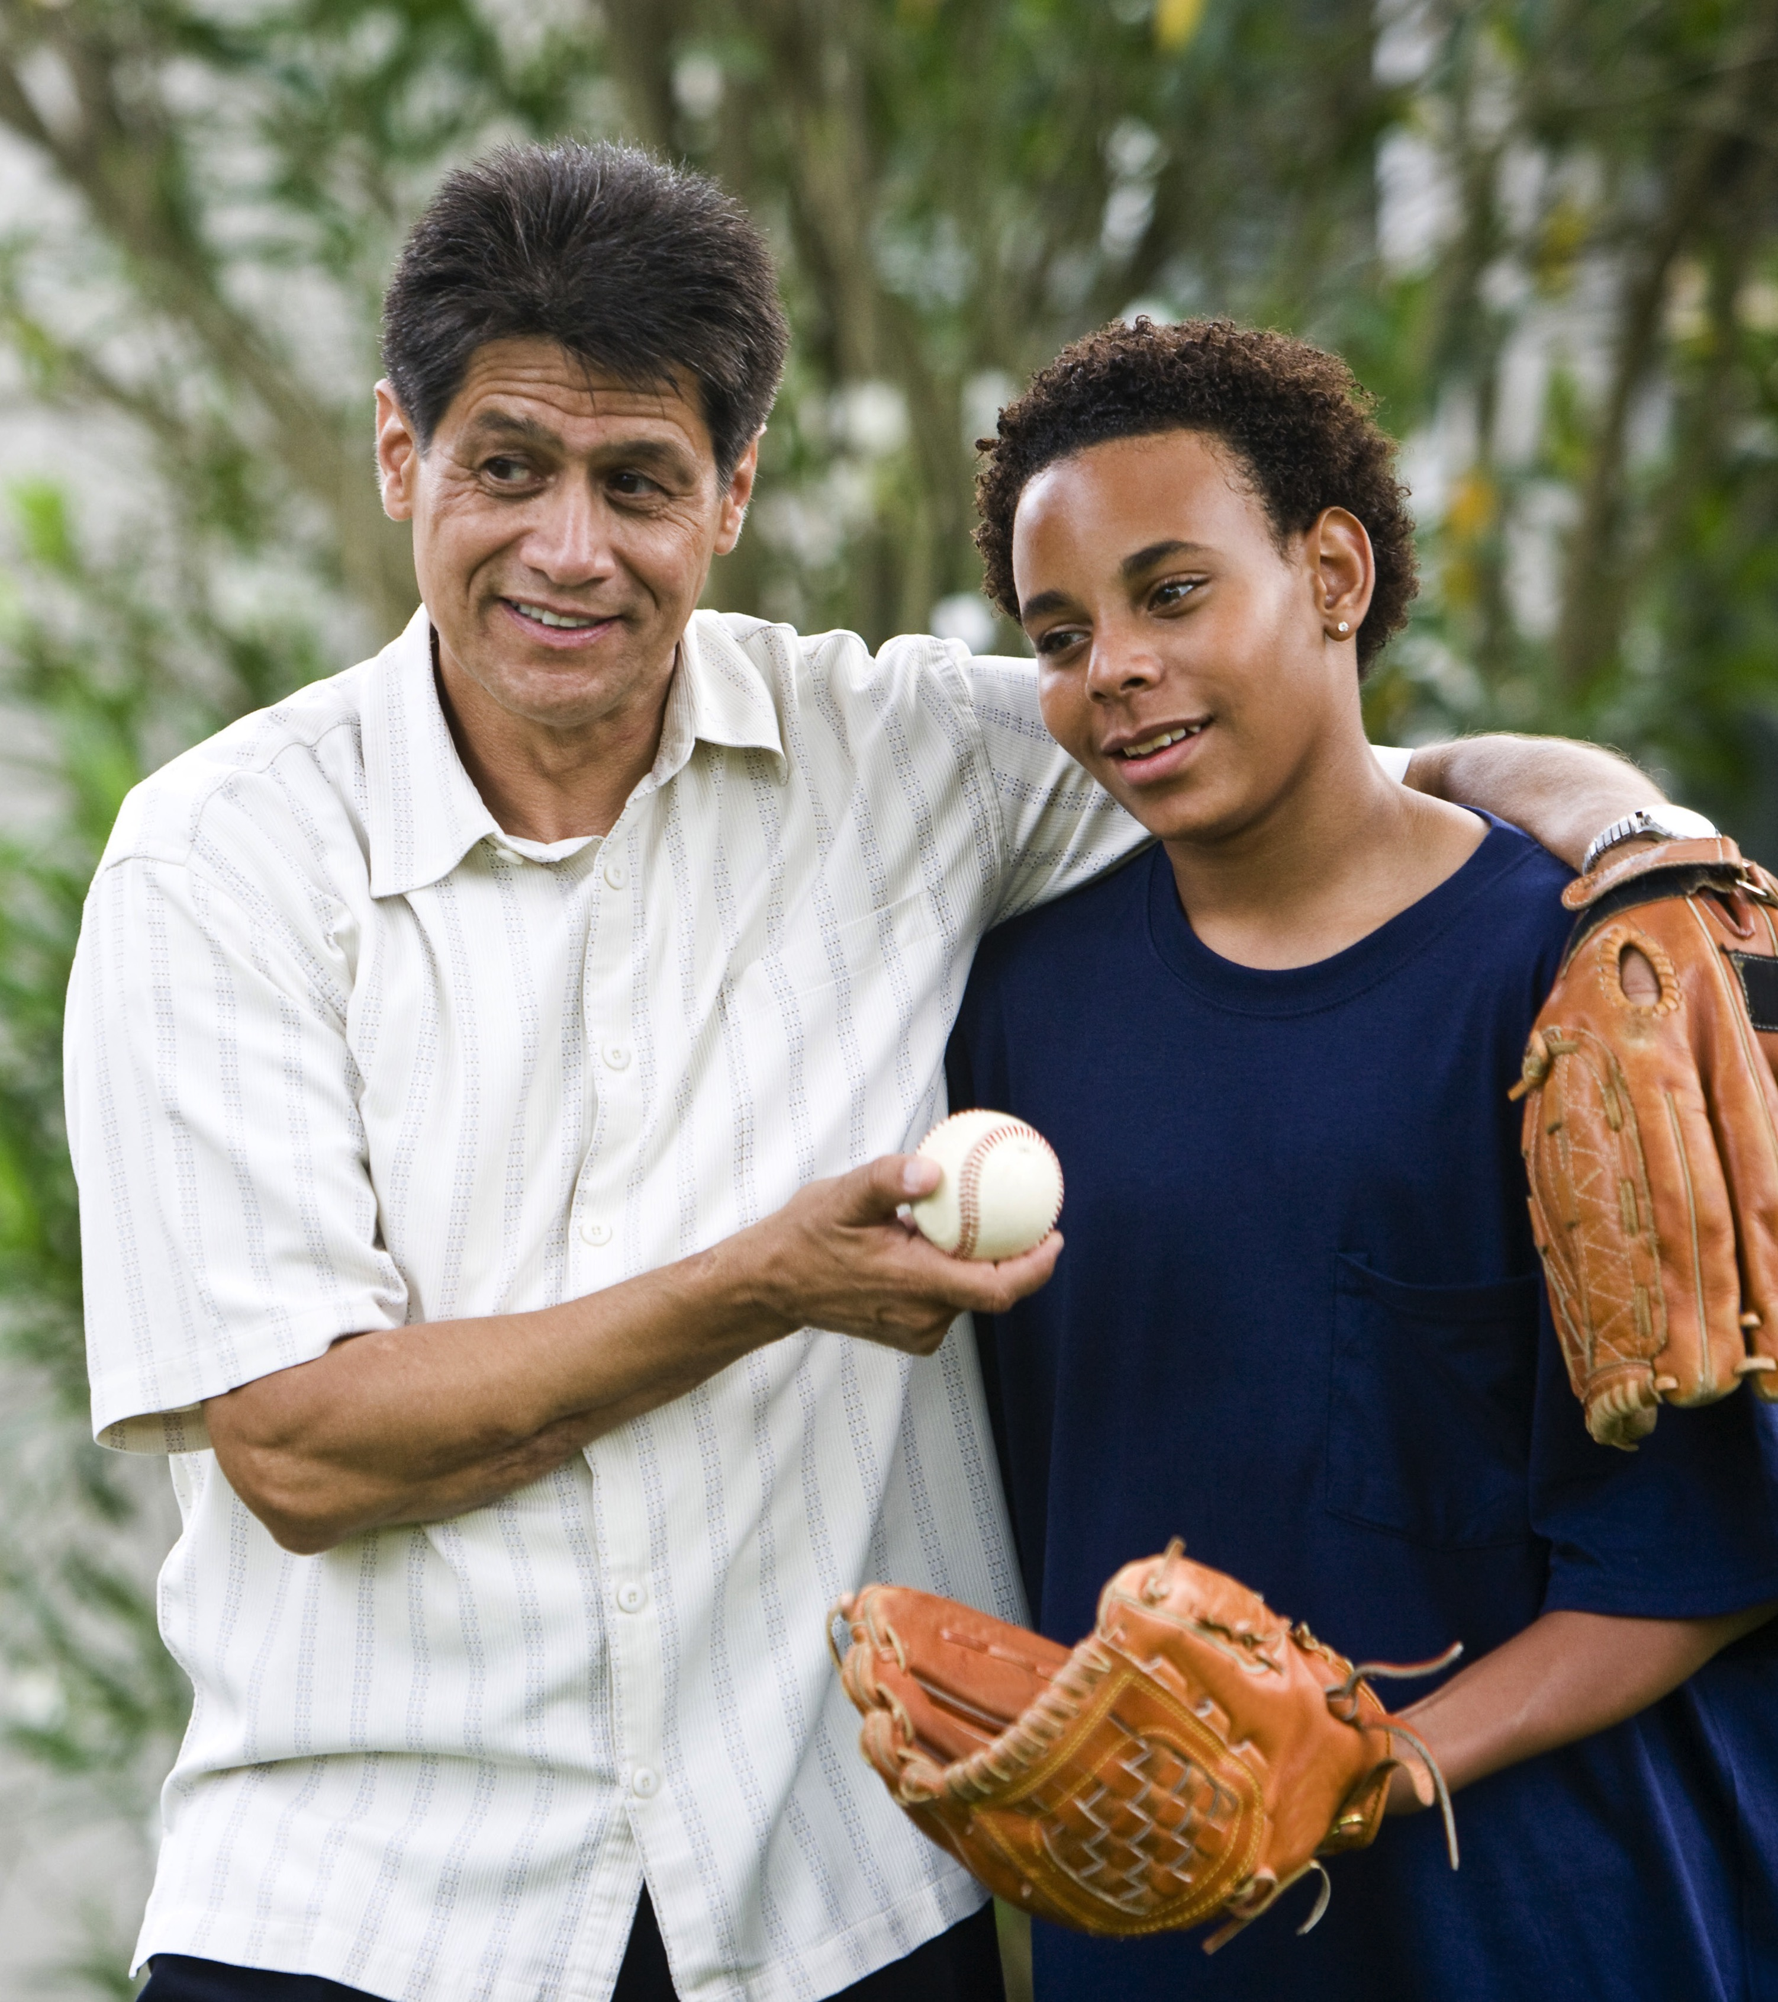
“Every child who winds up doing well has had at least one stable and committed relationship with a supportive adult”
Center on the Developing Child
– Harvard University

Slide 11
State Care and Statistics
31%
Less than 1%
50 to 80%
of homeless population was
in state care
of these children ever go to college.
of commercially sexually exploited children have been involved in the child welfare system.
25%
25%
of kids who “age out” of foster care never graduate high school.
by the age of 21 will become pregnant.

Slide 12

The mission of working with “At Risk” kids is not necessarily an invitation to the see “special miracles”, but a call to SOW into the generations to come. What we sow into these children’s lives may not have an immediate impact, but if we are faithful to sow into them what God has freely given to us we will reap a harvest.

Slide 13

Foster Care
Adoption
Therapeutic
Foster Care
Specialized Youth
Mentoring
Safe Families

